Slide 1
Steve Greenberg Innovation Insider
InnovationInsider@gmail.com
305-778-6787

Slide 2
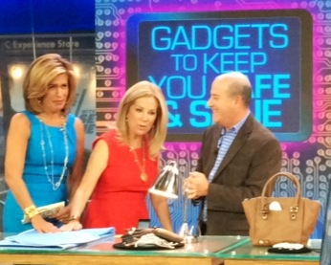
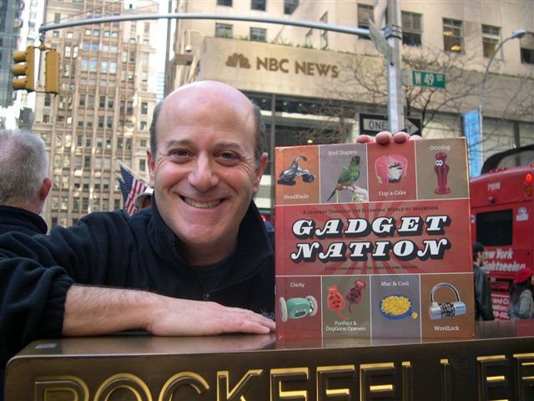
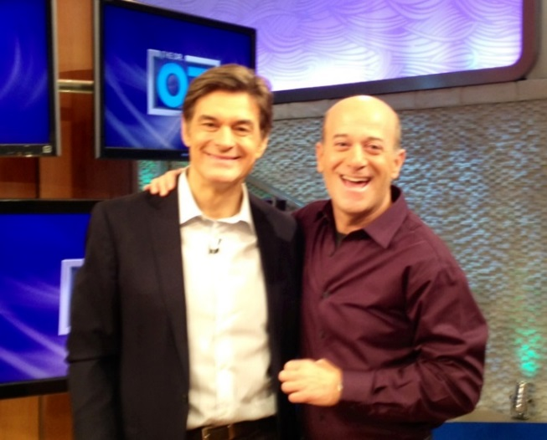
Background
Steve Greenberg is a recognized technology expert, TV personality and product scout. He is in the process of developing a series of segments for syndication on TV newscasts across the country and is looking for an editorially appropriate sponsor. More information on Steve Greenberg can be found at www.SteveGreenberg.tv

Slide 3
Experience & Reach
/SteveTV
1700+ likes
@stevetv
4300+ followers
/in/stevetv
 | Host of monthly tech & gadget segment | 2MM daily viewers | http://www.today.com
 | Regular health tech appearances |  | http://www.doctoroz.com
 | Co-host and co-creator | 1MM viewers | http://www.foodnetwork.com/shows/invention-hunters.html
 | Author | 100K+ copies sold | http://www.gadgetnation.net/index.htm
National morning news tour across top markets | Host of monthly tech & gadget segment | 1MM daily viewers
Steve’s Website:
stevegreenberg.tv
Demo Reel:
http://stevegreenberg.tv/Demo_Reel.html

Slide 4
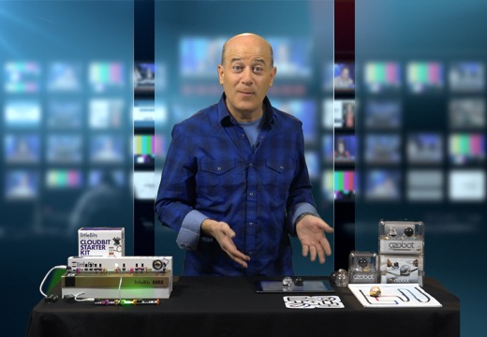
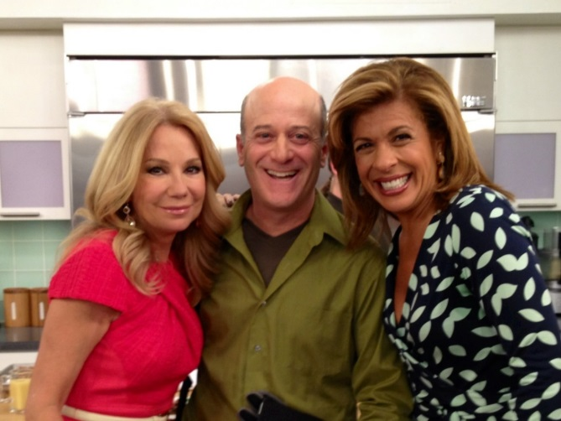
Project Brief
Concept
What’s Wow Now, a series of nationally syndicated technology/innovation television segments that will be seen in newscasts around the country
Produced and hosted by Steve Greenberg
Similar concept and reach potential as “Mr. Food”
Format
Editorially-driven segments showcasing 2-3 new products in each segment
Brief (approx. 90 seconds) segments 2x/week
Sponsored by a corporation with a link to innovation and entrepreneurship BUT is not actively selling products that would be featured in these segments
Reach
Initial reach of approx. 75 television markets; potential for expansion

Slide 5
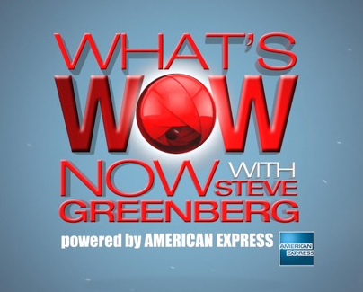
Sponsorship Opportunities
Sponsor’s Brand Placement Opportunities
Visual placement opportunities
Sponsor’s logo/name in opening graphics
Name featured in corresponding promo language
Verbal placement
Animated segment opening will include sponsor’s name/logo before every segment (e.g. “Welcome to What’s Wow Now powered by [Sponsor name]!”)
Sponsorship Benefits
Sponsor’s brand is linked to innovation
Opportunities for viewer engagement
Web engagement — associated segment site hosted by or prominently featuring sponsor and company information; links back to company website
Digital rights to segments — so segments can be used as content for sponsor’s website, social and editorial platforms, email marketing, etc.
Segments can be put on web with sponsor’s ad running before each segment
Access to Steve Greenberg for possible promotion and/or trade shows

Slide 6
Contact
Questions?
Contact Steve at InnovationInsider@gmail.com or by phone
at 305-778-6787

